Slide 1
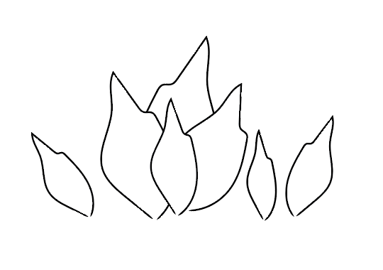
Flows of relatedness
IoT Bootcamp / capstone
Viola arduini

Slide 2
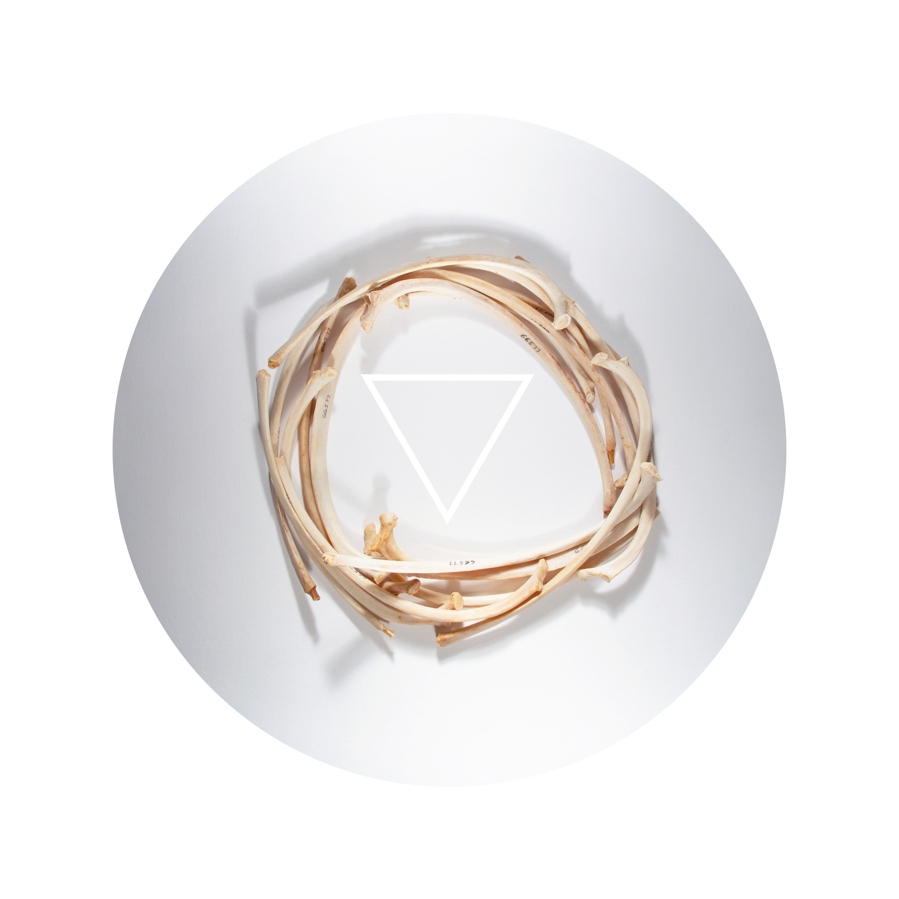
ABOUT me
Italian artist and researcher exploring the relationship between humans, nature, and technology
MFA in Art & Ecology from UNM
Currently STEM student in Biotechnology

Slide 3
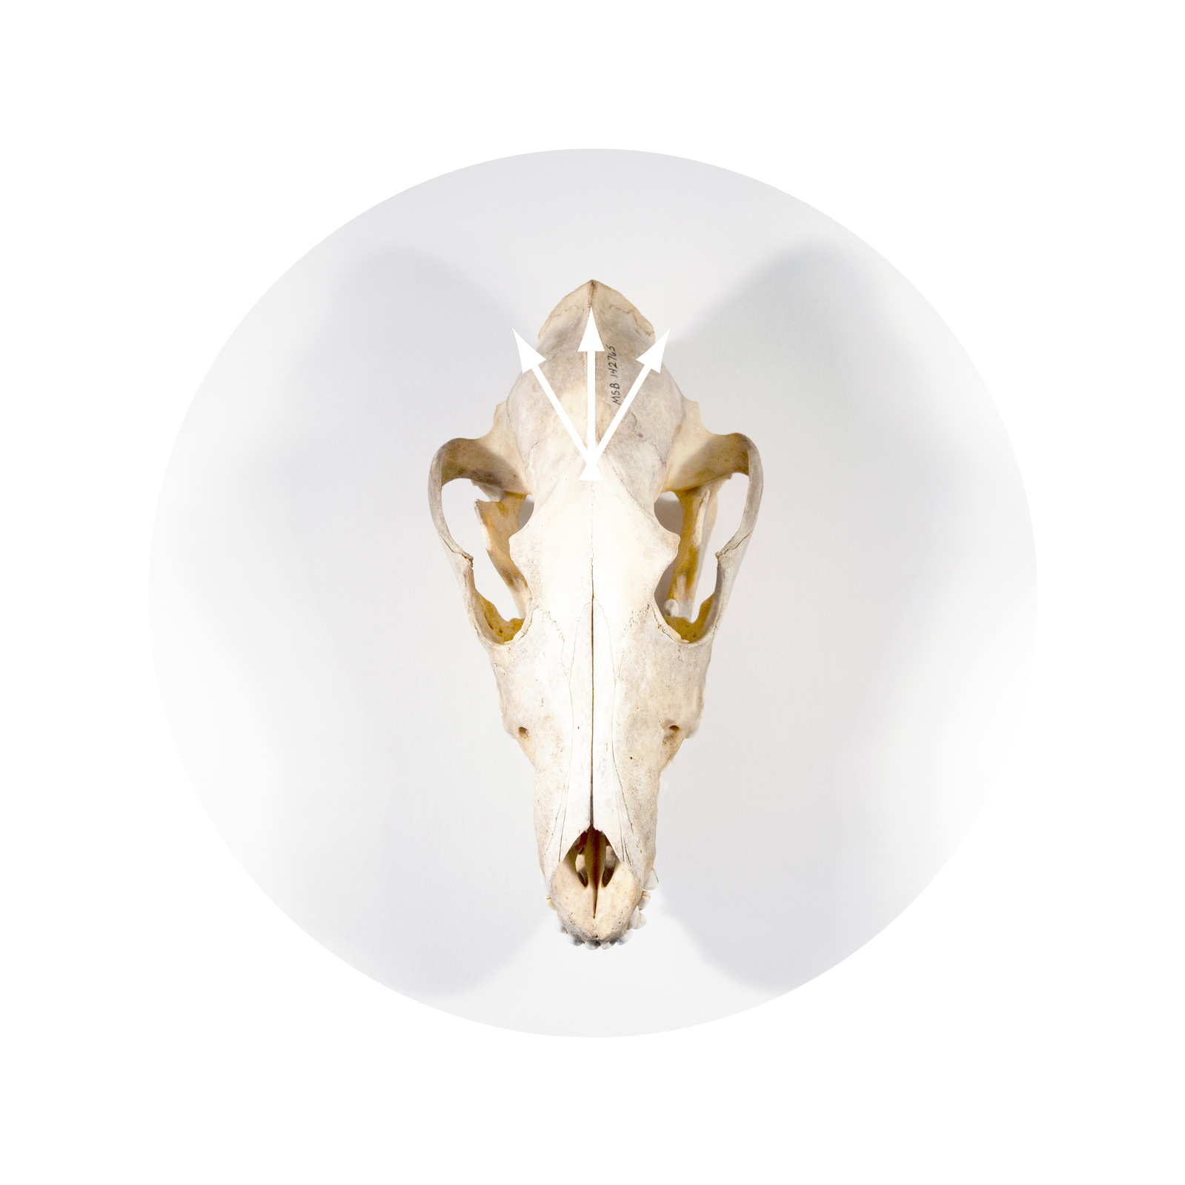
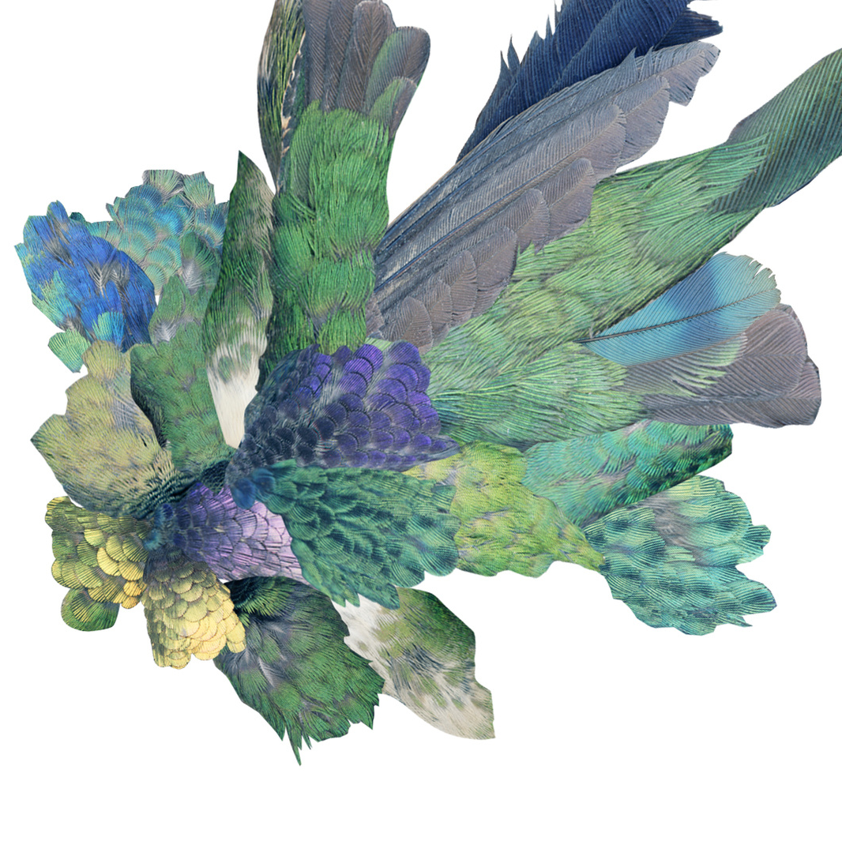
Left: Silver from Nina’s Story
Right: Hummingbird from The Chimera Manifesto

Slide 4
The project
An interactive installation for data embodiment.
To offer a point in space to perceive – at a human scale– two major flows that cross Albuquerque: the flowing south of the river and the yearlong birds’ migrations in their planet-wide breathing movements.
Hidden to most of us as we are separated by the urban, artificial environments, these movements represent important indicators for ecological, climatic, and biological health of the land that host and sustain the city and beyond.

Slide 5
The project
It uses publicly available datasets for the past year:
BirdCast by Cornell University, that utilize weather radars to estimate number of birds in flight per night during migration periods over New Mexico;
Water flow of the Rio Grande in Albuquerque by United States Geological Survey.
The installation is also formed by my recent participation with the UNM Turner Lab, that studies the genetic diversity of the Rio Grande fishes and its relations to drought and river flow.

Slide 6
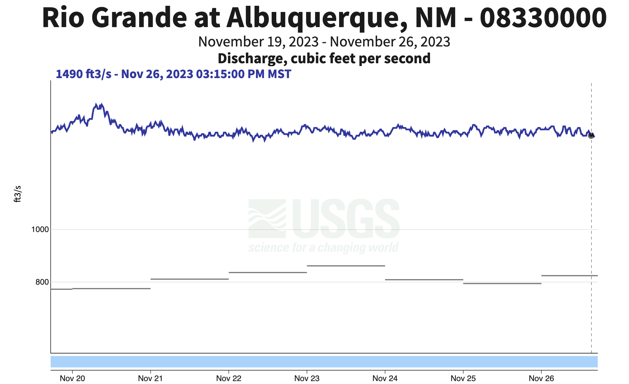
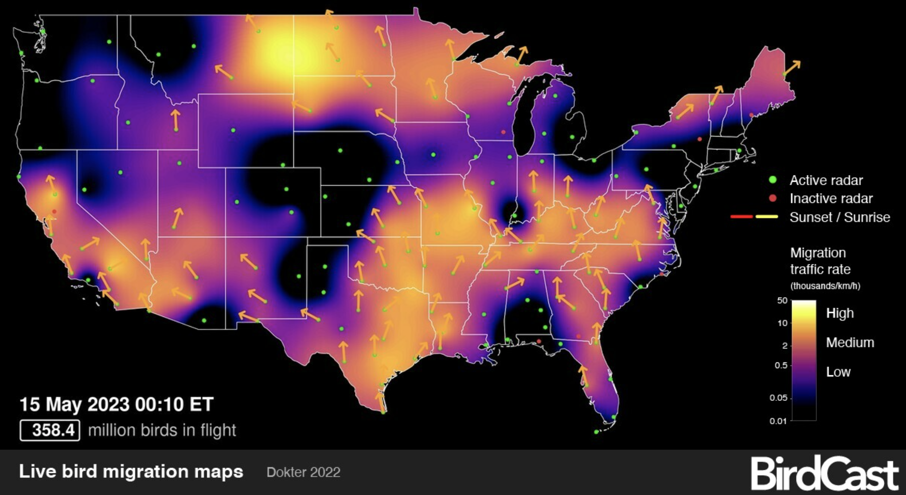

Slide 7
The installation
The installation is everchanging and composed of three main parts:
a sculptural piece inspired by the scale of the silvery minnow, that opens and closes based on the Rio Grande water flow.
a light installation made of an LEDs floor that lights up based on birds’ migration data in the region
an online repository for collective memory and investigation

Slide 8
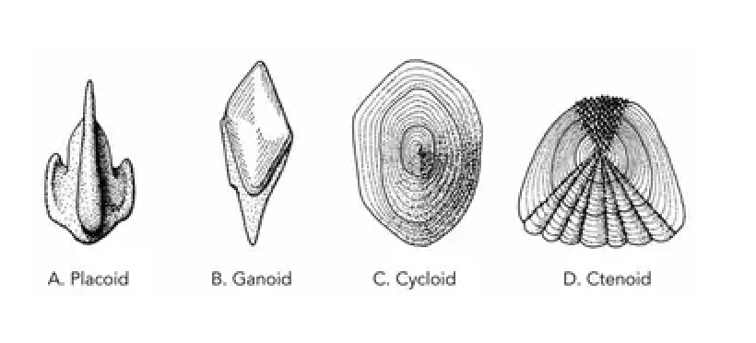
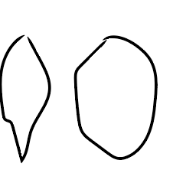
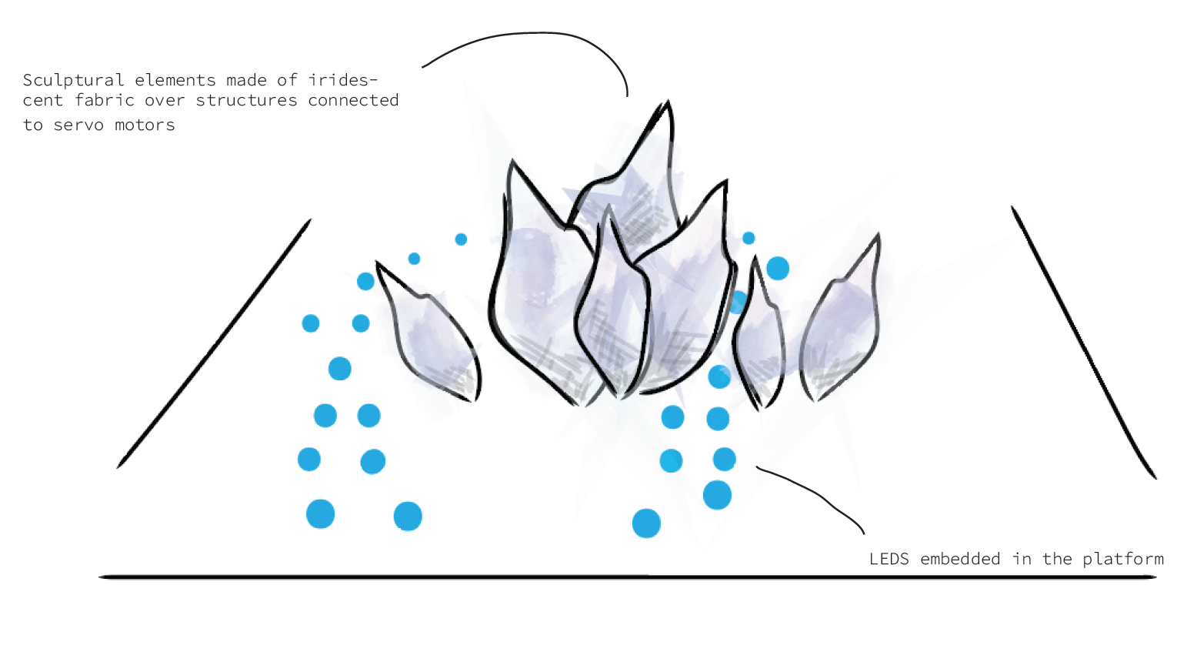

Slide 9
Parts
Particle Photon 2
Neopixels WS2812B RGB
MG996R Servo Motors
HiLetgo PCA9685 16 Channel 12-Bit PWM Servo Motor Driver IIC Module
USB / DC / Solar Lithium Ion/Polymer charger
Solar Panel
Battery

Slide 10
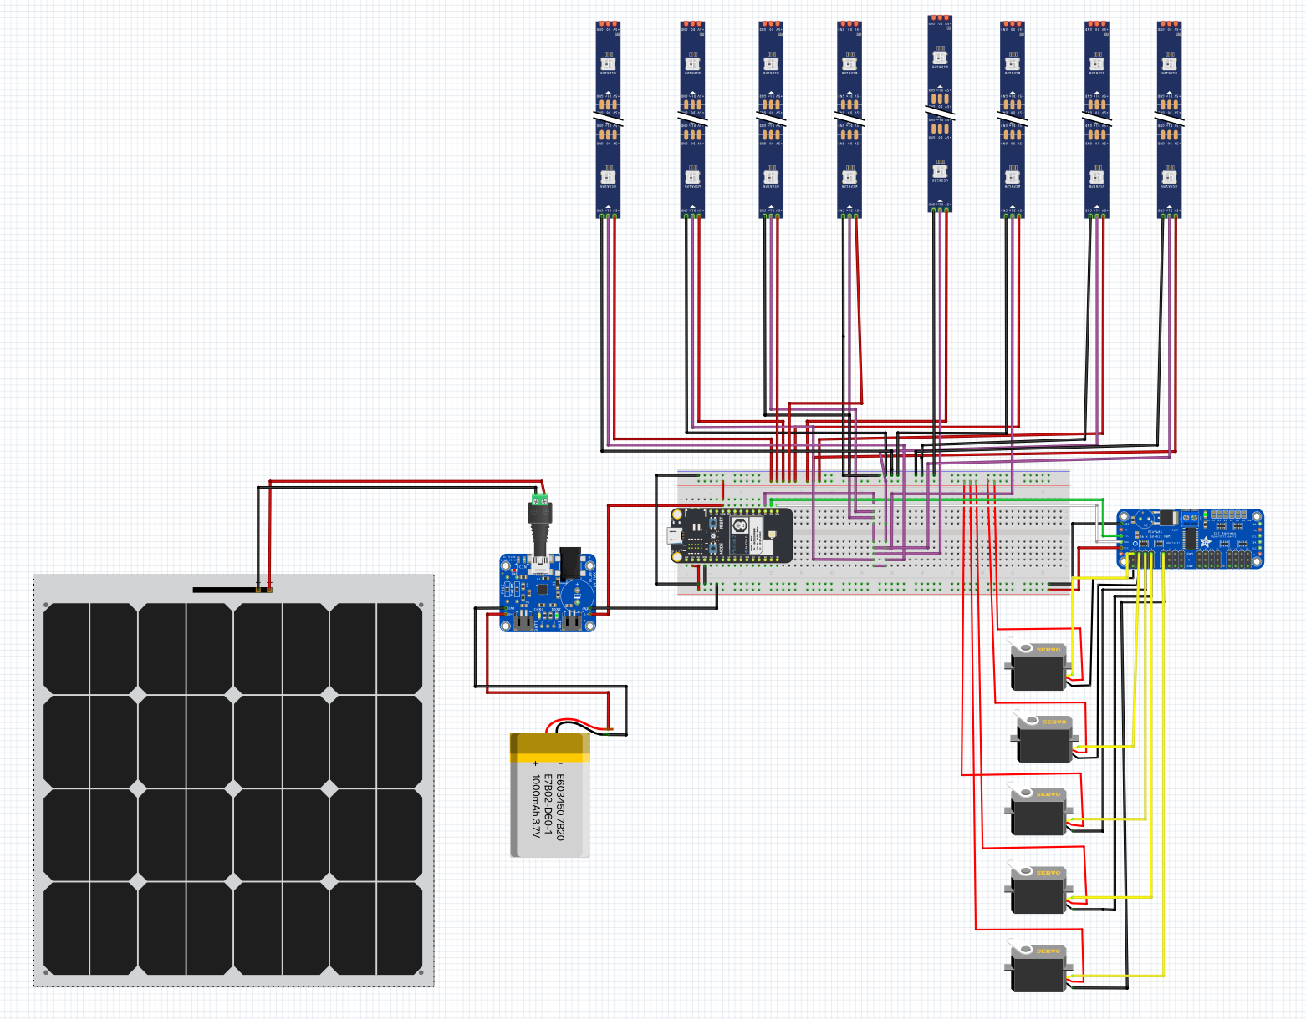
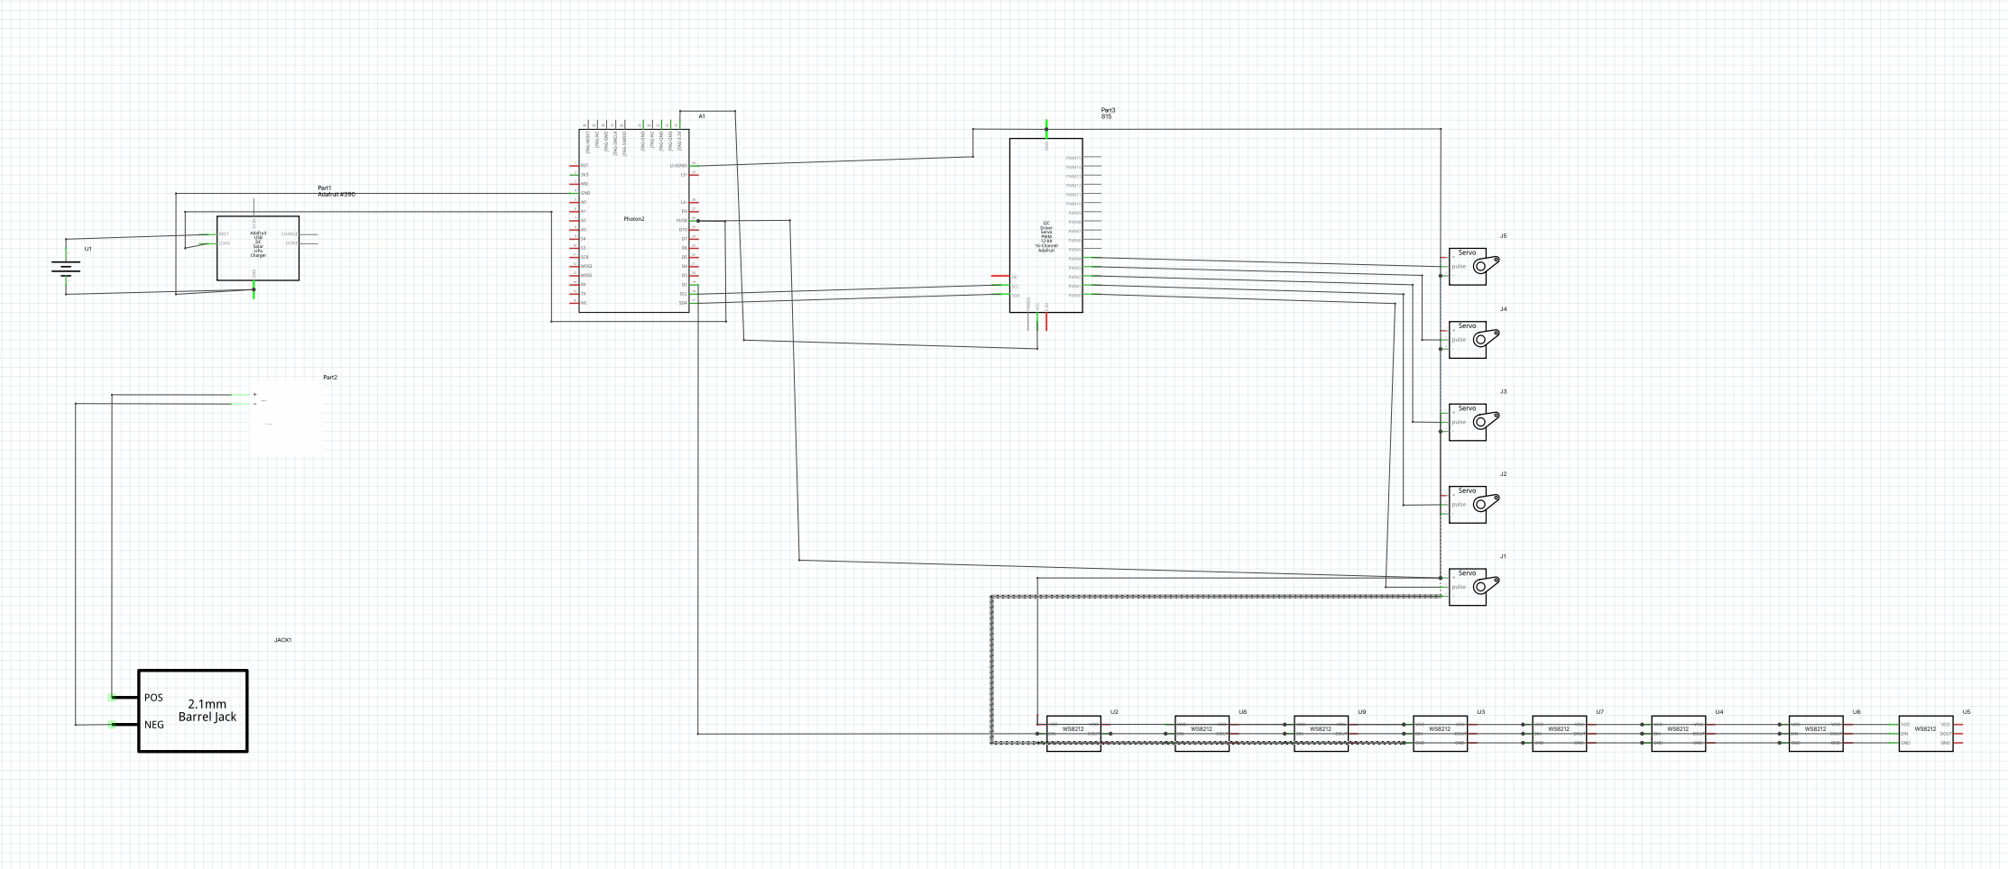

Slide 11
Parts
Laser cut base – 1/8 in wood & 1/8 acrylic
3D printed holders for servos installation
3D printed connectors for scales

Slide 12
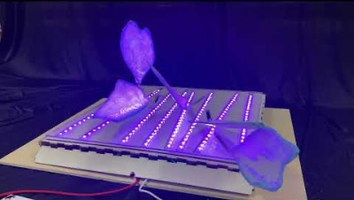
MaKING OF & DEMO

Slide 13
NEXT STEPS
FABRICATION
REAL TIME DATA
COLLABORATION WITH ENVIROMENTAL ORGS

Slide 14
THANK YOU
varduini@unm.edu
@violafromthesea
www.violaarduini.com
www.hackster.io/viola-arduini
Special thanks to Dr. Brian Rashap.
EJ Hishman, Carol K Cooper, & the City of Albuquerque.

